Slide 1

IACS X
Predicting the effects of genetic perturbation in maize
Final Presentation
Victor Avram, Sergio Jimenez, Eagon Meng, Wenhan Zhang

Slide 2
Project Overview

Slide 3
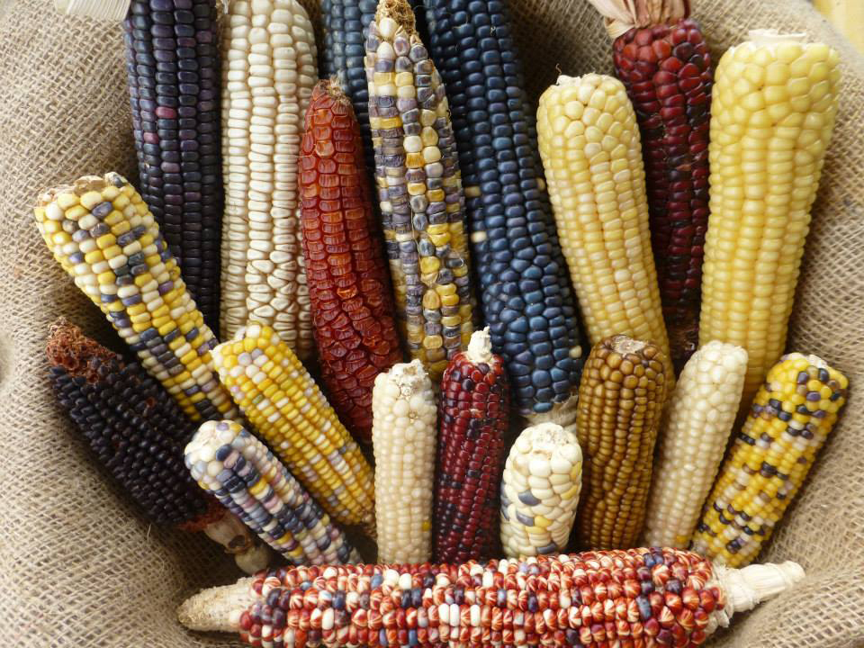
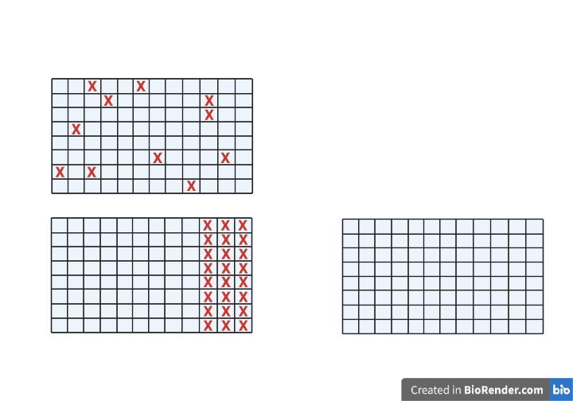
When given perturbations (in the form of gene expressions of a subset of genes), predict the gene expressions of the rest of the genes.
Editing effects
Reduced profiling
he household does any agricultural activity or not.
Our Task
40,000 Genes
?
480 Samples
Test
?

Slide 4
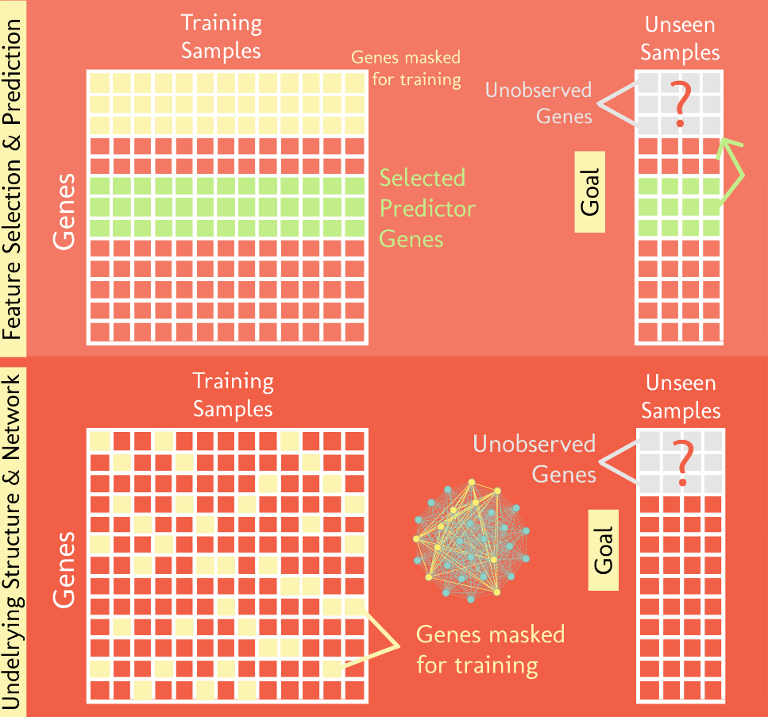
2 Paradigms
4 Routes

Slide 5
Route 1: Baseline Prediction Methods
Regression and ensemble methods with feature selection
Simple densely connected neural network without feature selection
Route 2: Prediction Using Landmark 1000 as advanced feature selection
Route 3a: Autoencoder + Regression
Dimensionality Reduction
Prediction from Latent representation
Route 3b: Imputation and Variational Autoencoder
Route 4: Graph Neural Networks
Roadmap
Feature Selection & Prediction
Underlying Structure & Network

Slide 6
Comparison
Routes | What are the predictors | Methods of selecting/processing of predictors | Predicting on what | Methods for predicting
1. Most correlated genes | The neighboring genes of each gene, in terms of strength of pairwise correlations | GENIE3 random forest | The expressions of each gene in the test samples | Various regressions
2. Landmark genes | The fixed Landmark 1000 genes | Dimensionality reduction -> stable clustering -> centroids | The rest of the genes other than L1000 | Various regressions
3. Imputation | The neighboring genes of each genes in terms of Euclidean distance | KNN | Missing gene expressions and missing genes in the leave-one-out test individual | KNN
 | Lower-dimensional space | Variational Autoencoders

Slide 7
Routes | What are the predictors | Methods of selecting/processing of predictors | Predicting on what | Methods for predicting
4. Graph Neural Network | Network representation of the given data (i.e. PPI, adjacency / connectivity matrix), Raw expression matrix | Uses graph autoencoders to simultaneously learn features of a network representation of expression data along with features of the expression data itself | Missing feature values (i.e. expression values) for a subset of nodes (i.e. genes) in the given network using feature values of surrounding nodes. | Imputation Prediction

Slide 8
Route 1: Prediction Using Most Correlated Genes

Slide 9
Route 1a) : Regression and ensemble methods with feature selection
GENIE3
Using random forest regression to calculate the pairwise correlation of all genes. For each gene, use as features the most correlated ones
1000 Most Expressive Genes
Get the Coefficient of Variation of all the genes and use as features the 1000 most expressive ones
Linear Regression
Lasso Regression
Lars Regression
Random Forest Regression (Bootstrap Aggregating)
Ada Boosting Regression
Gradient Boosting
Regressions of different types

Slide 10
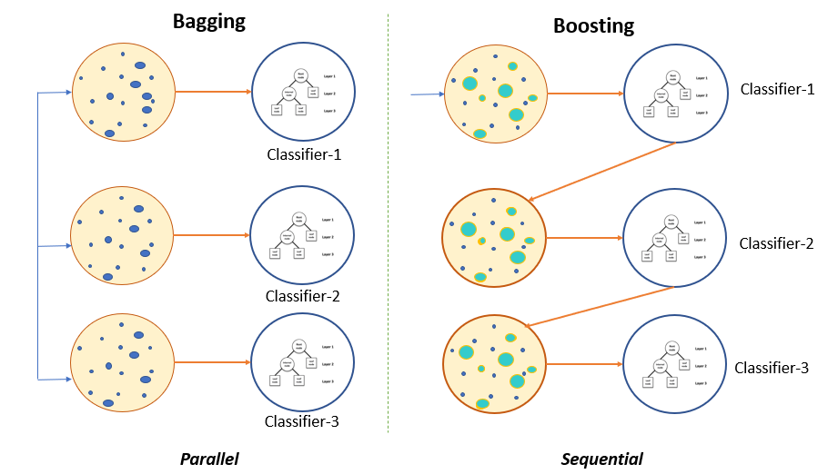
Ensemble Models

Slide 11
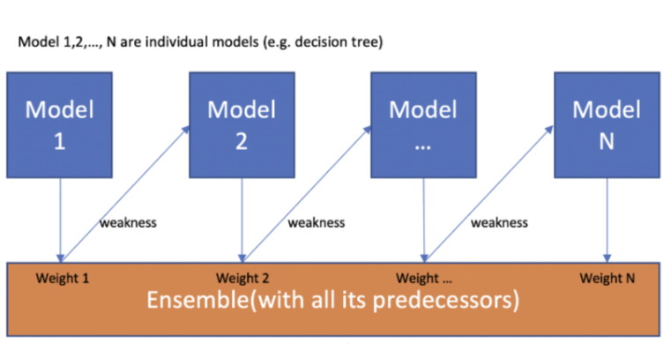
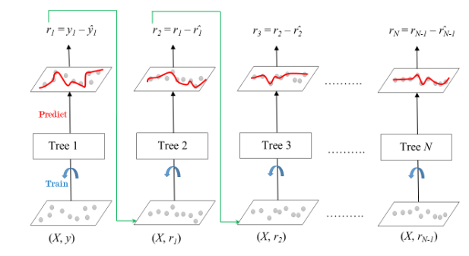
Types of Boosting models used: Ada Boosting vs Gradient Boosting
Ada Boosting
Gradient Boosting

Slide 12
Feature Selection: GENIE3 vs 1000 most Expressive Genes
GENIE3
1000 Most Expressive Genes
Calculate pairwise correlation of 4000 genes using GENIE3
For each gene, use as features the ones that have above 0.01 or more correlation
Train and run Models using a 70-30 train-test split
Calculate R^2s of the test set
Getting both standard deviation and average of expressions across all samples per gene, dividing and then sorting (Coefficient of Variation)
Take the 1000 most expressive genes and use them as features to predict the next 1000 most expressive genes
Train and run Models using a 70-30 train-test split
Calculate R^2s of the test set

Slide 13
Route 1a: Baseline Models with feature selection results
 | Mean of R^2 GENIE3 | Mean of R^2 1000 Most Expressive Genes
Linear Regression | 0.49 | -1.9e+16
Lasso Regression | 0.51 | -27.07
Lars Regression | 0.49 | -7.88
Random Forest Regression | 0.65 | -1.61
Ada Boosting Regression | 0.58 | -2.31
Gradient Boosting | 0.63 | -4.08
Even though the 1000 most expressive genes method allows us to use the same features for all predictions, results were significantly worse than in GENIE3

Slide 14
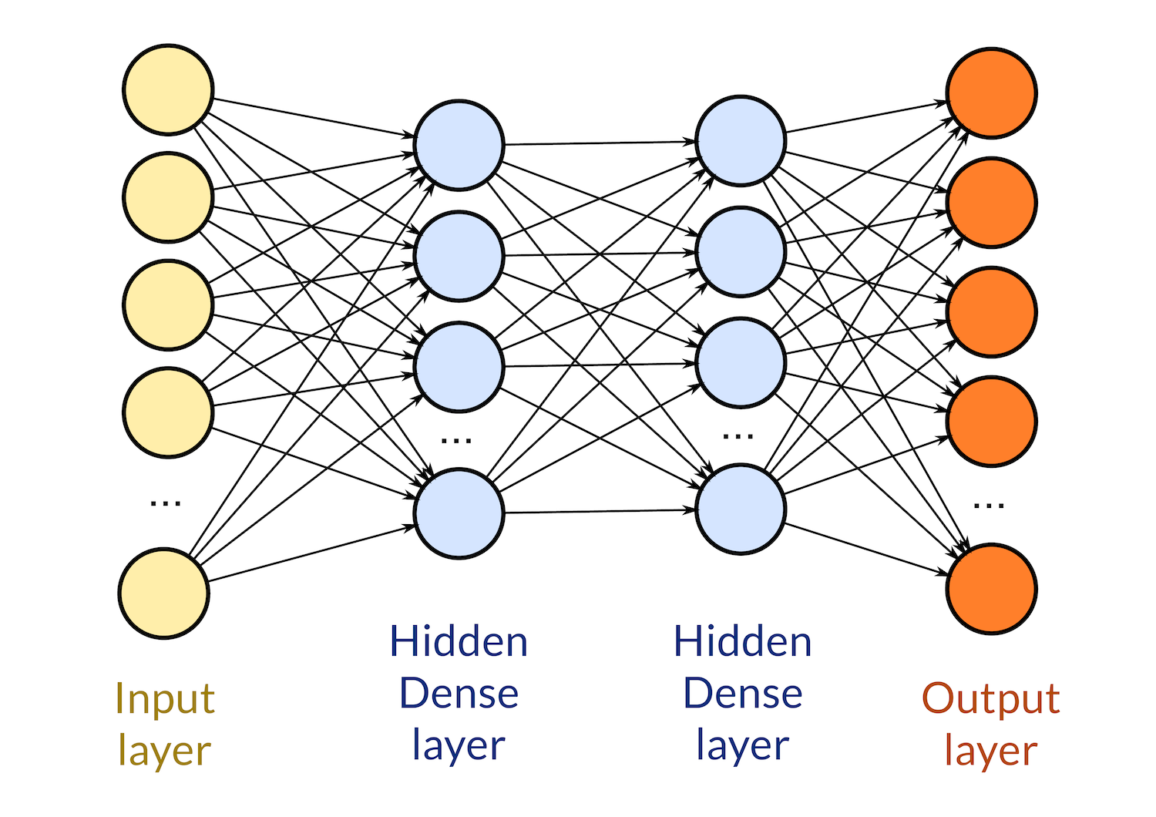
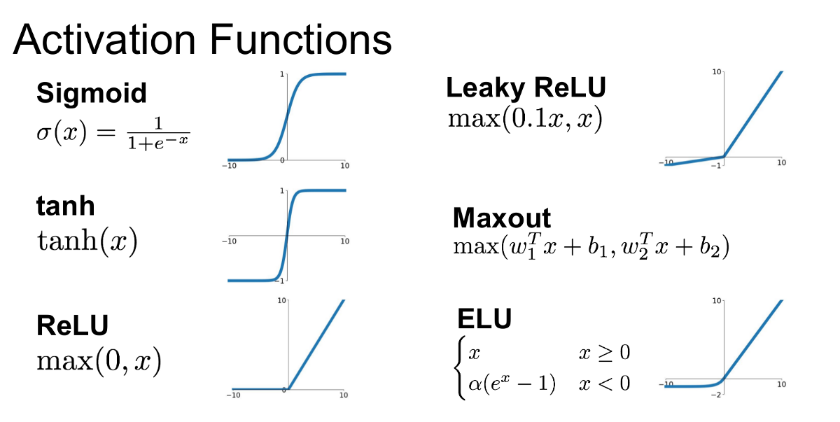
Route 1b) : Simple densely connected neural network without feature selection
Neural Network also lacked in performance
Using a Neural Network of Dense Layers and ReLu activation functions a negative test R^2 of -2.07 was obtained

Slide 15
Route 2: Prediction Using
Landmark 1000 Genes

Slide 16
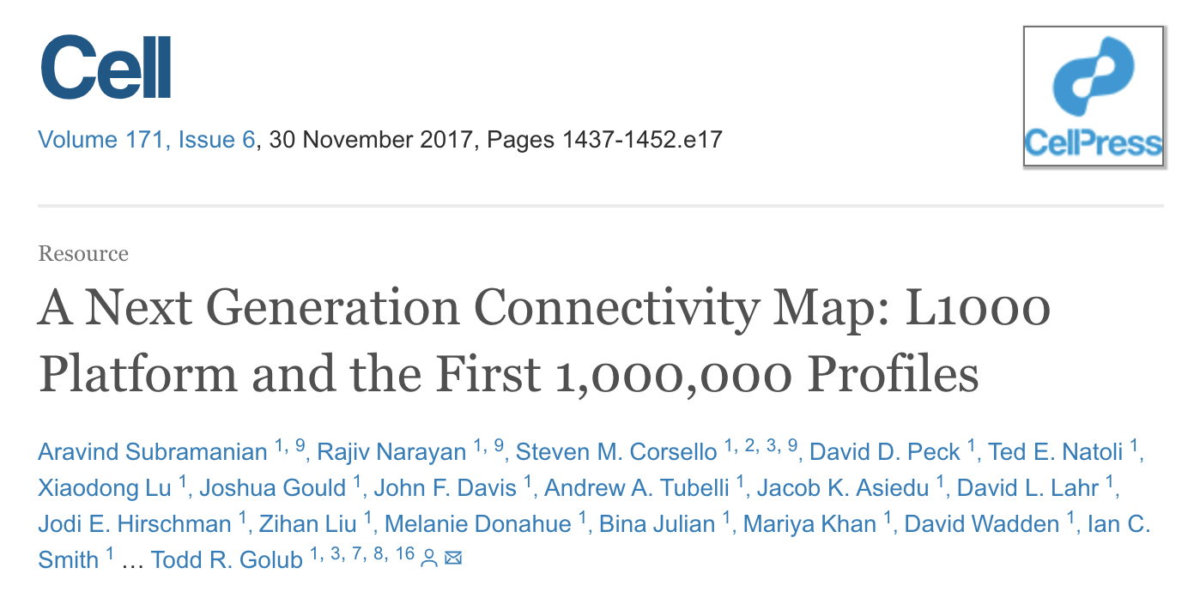
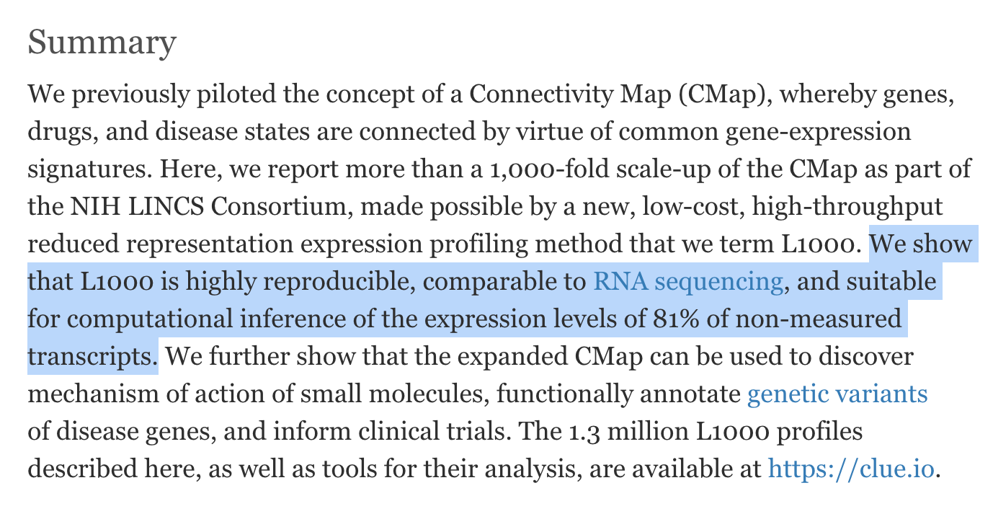
Route 2: Landmark 1000
Intuition
We can also select the most significant Landmark 1000, and use them to predict the rest.
Advantage
Similar to our problem;
Extension of our feature selection route
Disadvantage
Their data is perturbation-drive, while ours only has natural variability;
We are training on 4 times as many genes as they were;
We have 480 samples and they have 1.3 million profiles.

Slide 17
Key Components of L1000
Dimensionality reduction
PCA, t-SNE
1
Cluster analysis to cluster the genes
K-means, DBScan
2
“Bootstrapping” subsamples, repeat the above process to try to obtain different clusterings
3
Identify centroids, i.e. genes that are stably in the center of clusters
Iterative peel-off
4
Consensus matrix to see which genes are always in the same cluster, marked as Landmark 1000 genes
5
6
Using L1000 genes to predict every other gene.

Slide 18
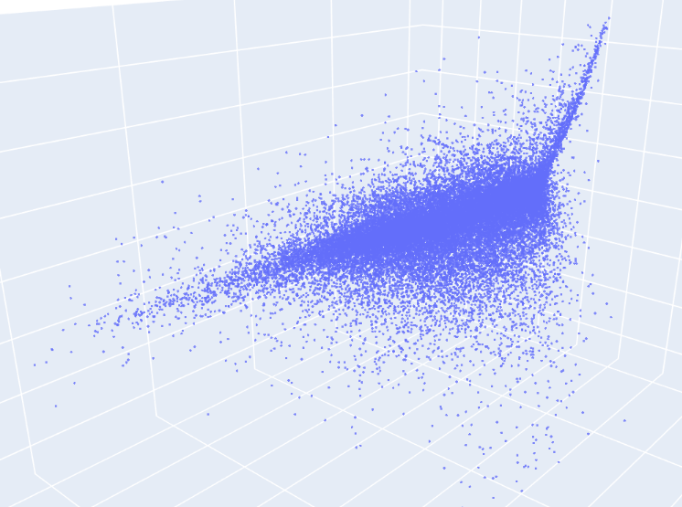
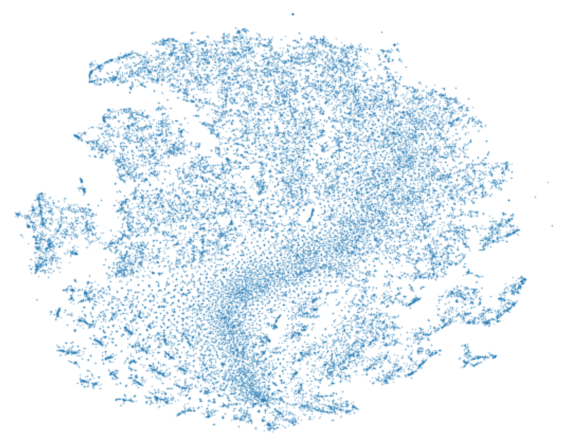
Dimensionality reduction
1
PCA
t-SNE

Slide 19
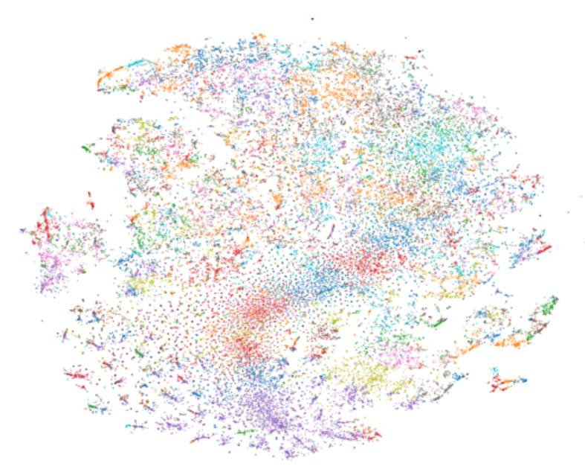
Clustering (K-means, etc.)
2

Slide 20
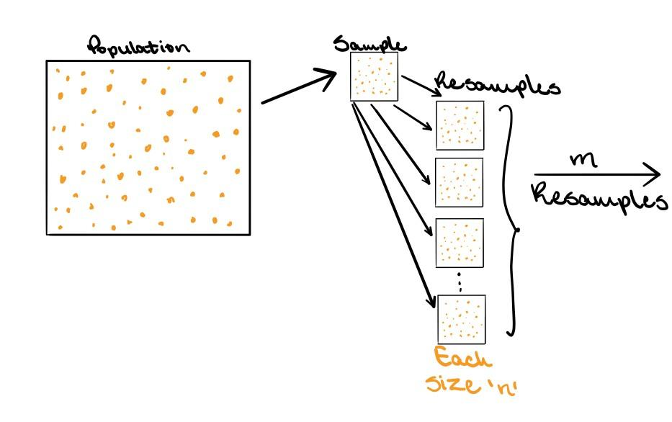
“Bootstrapping” and iterative peel-off
3
m = 100
n = 75% of total data
Partial image by Trist’n Joseph, https://towardsdatascience.com/bootstrapping-statistics-what-it-is-and-why-its-used-e2fa29577307

Slide 21
Consensus matrix to identify stable pairs and clusters
4
 | 1 | 2 | 3 | 4 | 5
1 | - | 8 | 6 | 1 | 8
2 | - | - | 3 | 5 | 2
3 | - | - | - | 8 | 7
4 | - | - | - | - | 0
5 | - | - | - | - | -
Stable clusters
[1, 2], [1, 5], [3, 4]
[1, 2, 5], [3, 4]
No. of times the two genes are
grouped in the same cluster

Slide 22
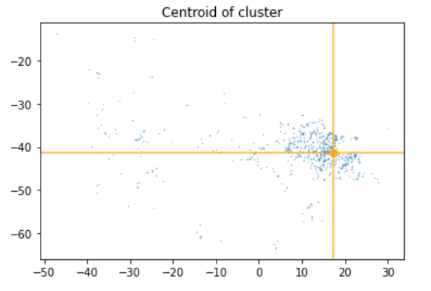
Identify centroids
L1000 as predictive input
5
6

Slide 23
Problem 1: Large clusters due to low variability in data
Iterative peel-off to get centroids results in huge loss of information, making this method unsuited for our non-perturbation-driven data.
Problem 2: 4x more genes, 16 times larger matrix
On our dataset, the computation became impractical in terms of storage, memory and time.
Noise
Overly large clusters

Slide 24
Route 3: Autoencoder-Based Methods for Gene Expression Prediction

Slide 25
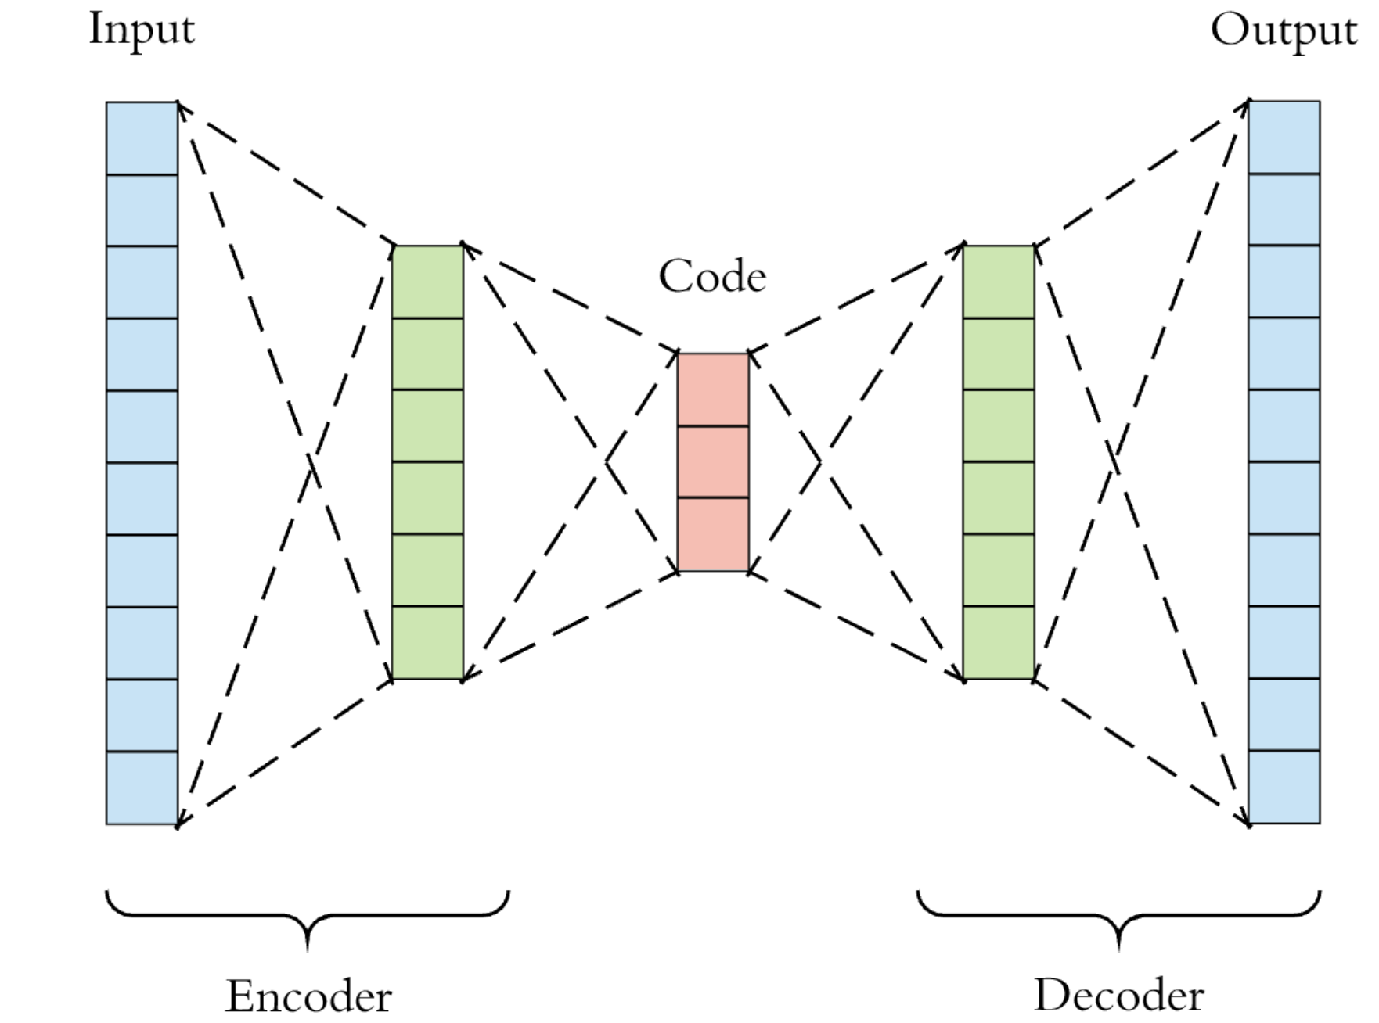
Route 3: Autoencoder + Regression
Can we learn general features of a subset of the expression data that are informative of another subset of genes?
Latent
Representation
Z
Ideally:
X ≅ X’
X
X’

Slide 26
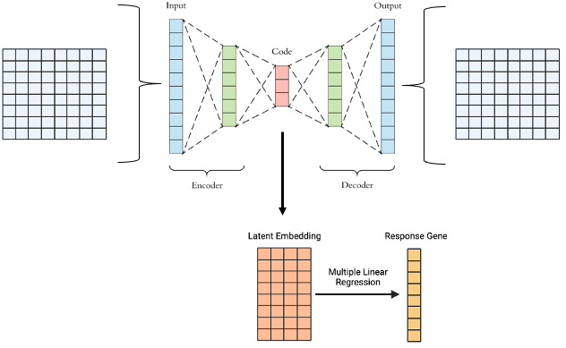
Route 3: Autoencoder + Regression
Can we learn general features of a subset of the expression data that are informative of another subset of genes?
Reconstructed Predictor Set
Predictor Set
genes
genes
samples
samples

Slide 27
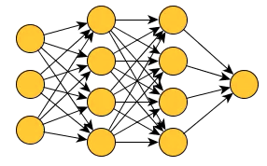
Route 3: Autoencoder + Regression Performance
Vanilla Neural Network
VS
Much worse performance than a vanilla neural network with dropout.
Better to be privy to all the data.

Slide 28
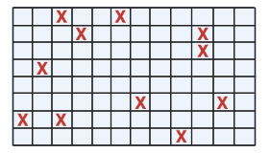
Route 3: Imputation of Missing Values
Genes
Imputation is a common task on single-cell data that aims to mitigate the effects of dropout.
Well-documented
Can be translated to bulk RNA-seq
Samples
X = masked value

Slide 29
Route 3: Variational Autoencoder Imputation
Latent
Distribution
P(Z|X)
Ideally:
X ≅ X’
X
Sample from latent distribution
X’
Notes:
We can think of variational autoencoders as regularized autoencoders that are prevented from overfitting and whose latent spaces have good properties. Instead of creating points in a latent space, we are deriving a latent distribution for each sample.

Slide 30
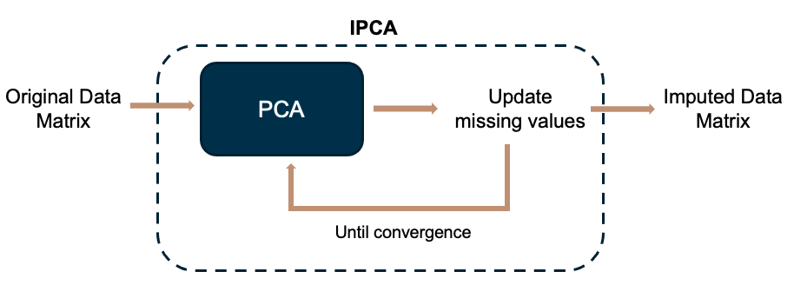
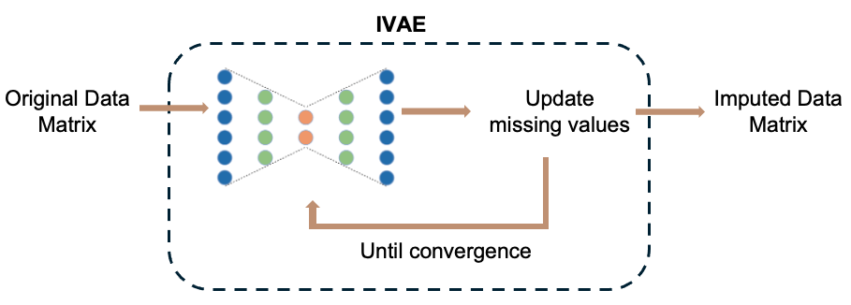
Route 3: Iterative Variational Autoencoder Imputation
Notes:
An autoencoder takes an input X, creates an encoding of X, and attempts to reconstruct X (this is the output X’) from the encoding. Autoencoders follow an encoder/decoder architecture. Ideally, the output will be identical to the input. Typically, an autoencoder creates a lower dimensional encoding of the input.

Slide 31
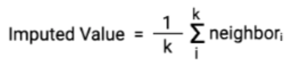
Route 3: Imputation of Missing Values
Naive Mean Imputation
k-NN Imputation
Iterative VAE
VS
VS
Use mean expression level of a given gene as imputed value
Define k-nearest neighbors gene network

Slide 32
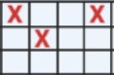
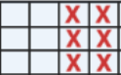
Imputation Results
 | Naive Mean - R² | k-NN - R² | Iterative VAE - R²
Scenario 1: 5% of entries missing | 0.7231 | 0.9073 | 0.8985
Scenario 1: 10% of entries missing | 0.7235 | 0.9075 | 0.9052
Scenario 1: 50% of entries missing | 0.7223 | 0.8801 | 0.8936
Scenario 2: 5% of genes completely missing | 0.7135 | 0.9070 | 0.9034
Scenario 2: 10% of genes completely missing | 0.7206 | 0.9068 | 0.8981
Scenario 2: 50% of genes completely missing | 0.7217 | 0.8923 | 0.8941

Slide 33
Route 4: Graph Neural Networks

Slide 34
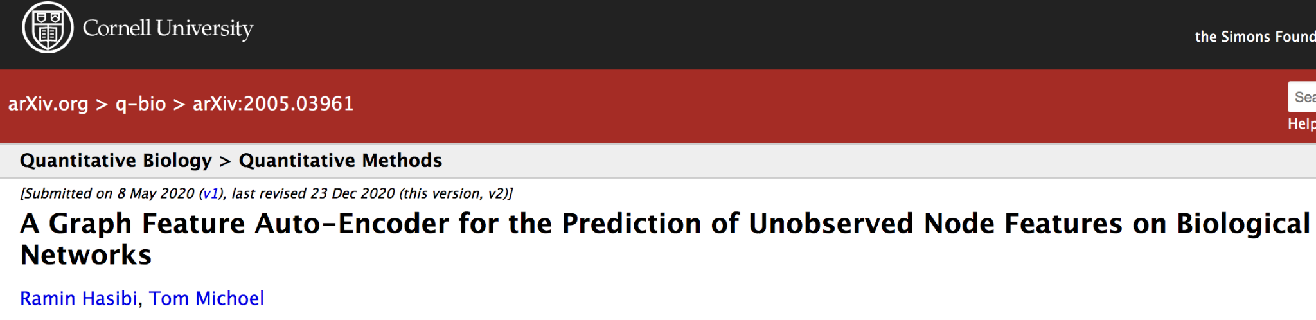
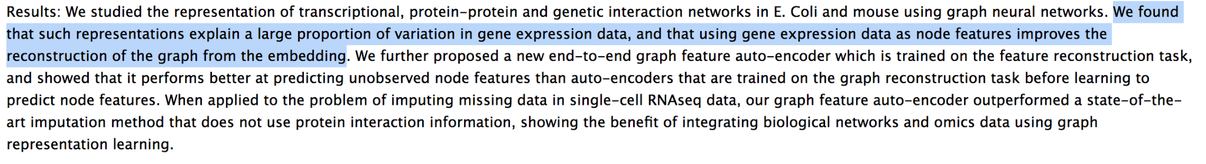
Route 4: Based on research from Hasibi et al., (2020)
Intuition
We can use graph autoencoders to simultaneously learn features of a network representation of expression data along with features of the expression data itself to predict expression values for a subset of nodes in the given network using feature values of surrounding nodes

Slide 35
Graph Neural Network Roadmap:
Maize protein-protein interaction (PPI) network - Expression Data: Establish causal links between nodes in the network
1
Reconstruct a network representation of the given data (e.g. adjacency matrix, similarity matrix)
2
Graph Autoencoder Scheme: Missing expression values for a subset of nodes in the given network derived using surrounding nodes.
3
4
Prediction of Expression values: Imputation and Prediction
5
Complications

Slide 36
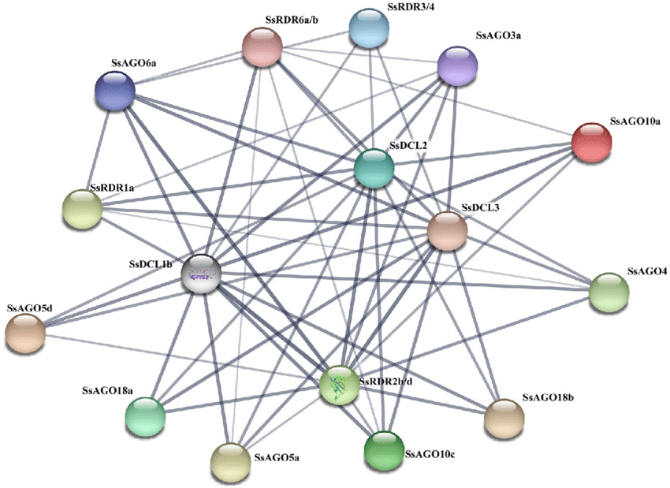
Use of PPI Network to subset the expression data
1

Slide 37
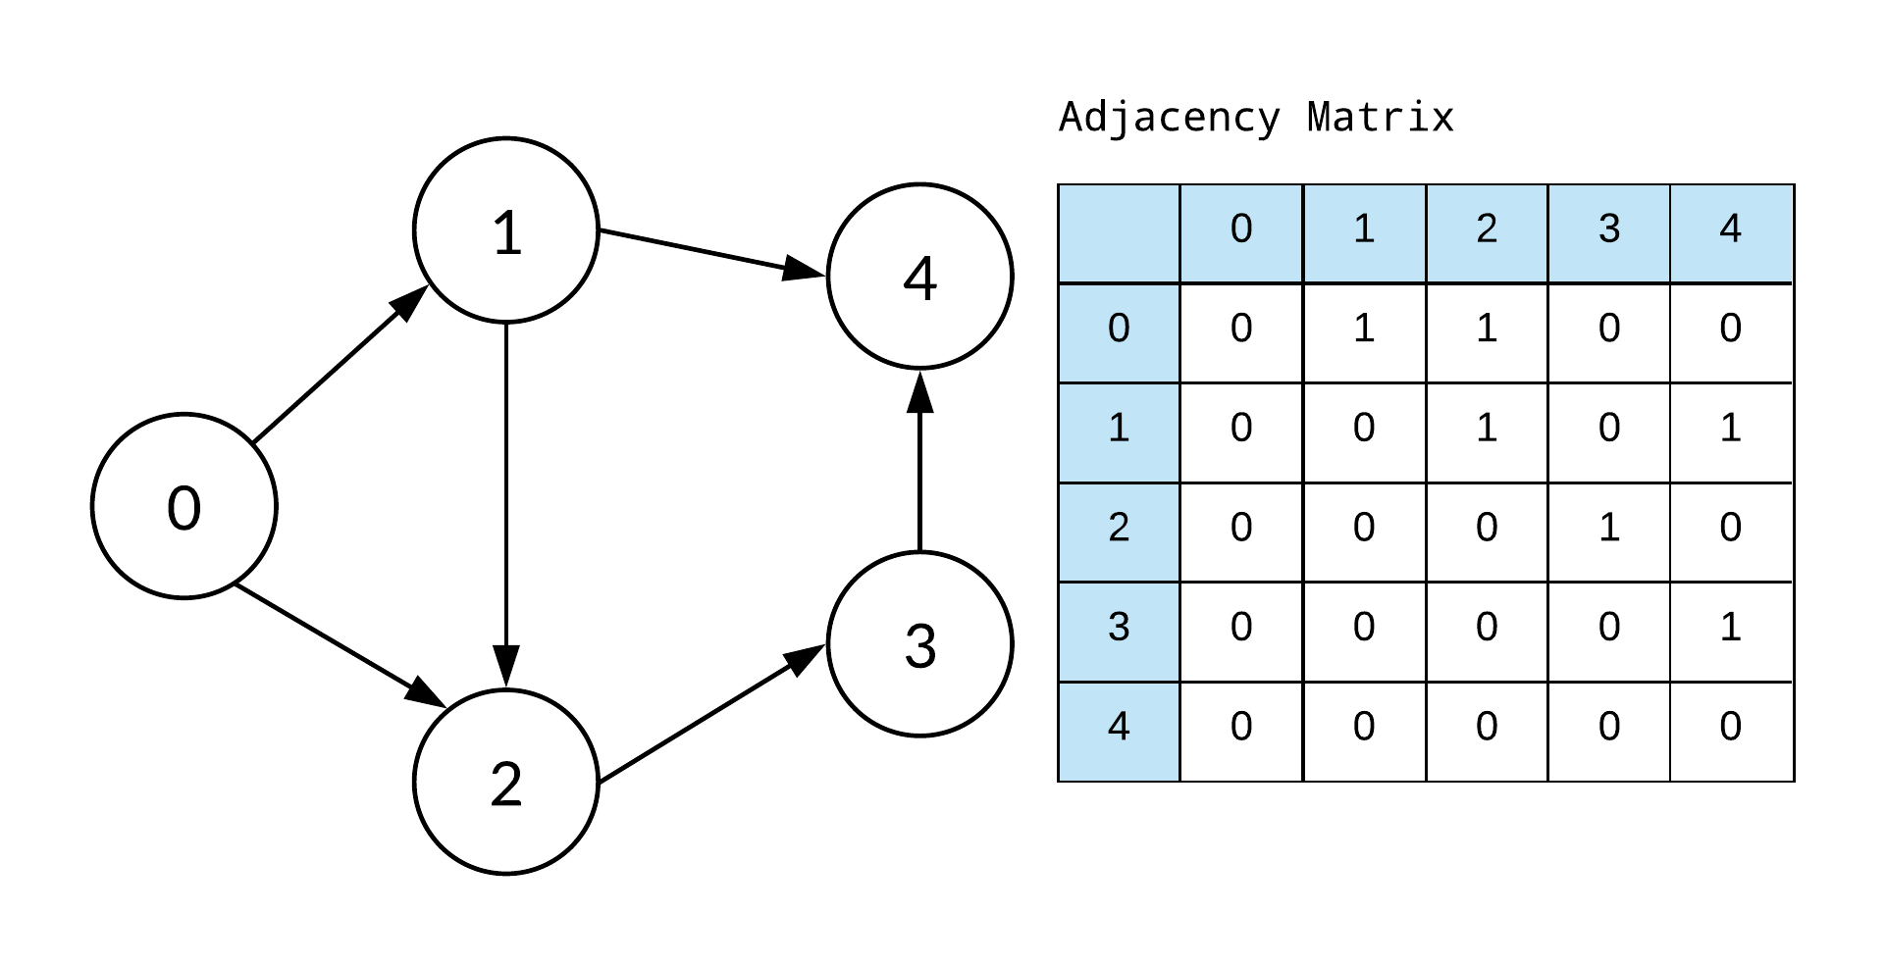
Adjacency Matrix
2

Slide 38
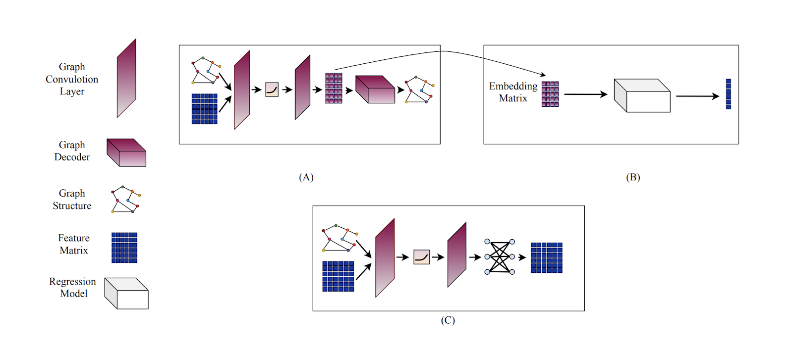
3
Graph Neural Network and Autoencoder Schemes
Graph Autoencoder scheme tailored to reconstruction of the adjacency of the graph
Take the Embedding matrix of graph auto-encoder and train an indirect regression task for prediction of the expression values
Proposed approach of graph feature auto-encoder for end-to-end learning of graph node features

Slide 39
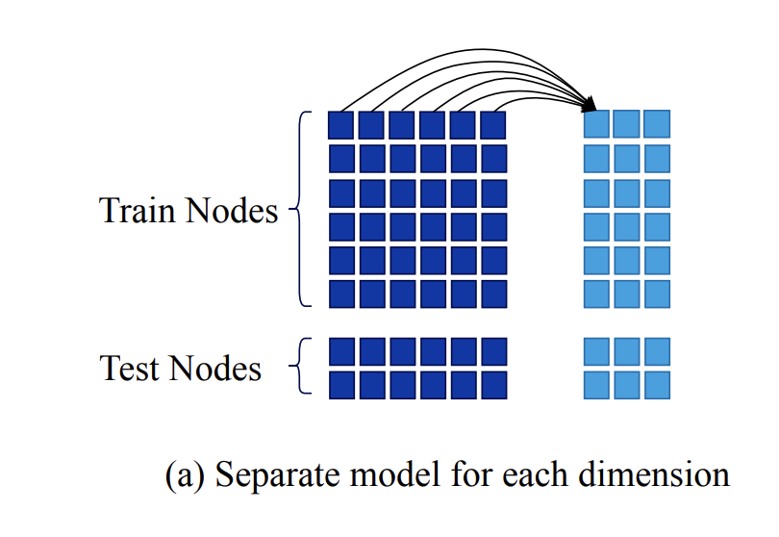
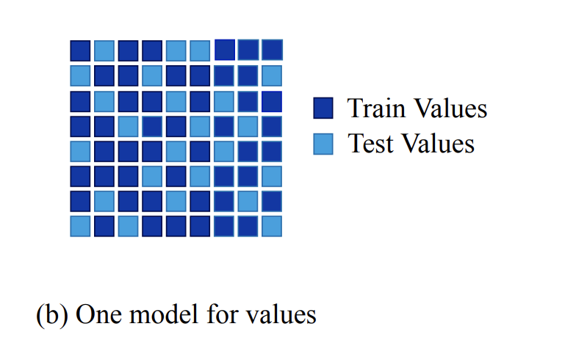
Methods of Prediction of Expression values
4
Prediction
Imputation
Each dimension of Y is predicted
using a model trained on X
A single model is used to predict all values of the feature matrix.

Slide 40
Challenges and Research Advancements
5
Graph Embedding -> Prediction is extremely computationally expensive
Training separate model for every desired gene output
Highly unstable, susceptible to poor choice of genes
Identified and confirmed a subtle bug in existing implementation
Data leakage in training allowed the model to peek at test data
Studied the logistical weaknesses of the imputation model
Current implementation assumes arbitrary training sample size as layer size
This prevents exploratory analysis and targeted one-off imputation
Active area of research: Hasibi has indicated the above is precisely where he suggests proceeding next in future papers

Slide 41
Conclusion and Future Work

Slide 42
Route 1: Baseline Prediction Methods
Confirmed the complexity of the problem: classical and naive methods are a poor fit
Route 2: Prediction Using Landmark 1000 as advanced feature selection
Gene selection is critical for sensitivity analysis
Perturbation driven data sets are optimal - without variability, certain methods are infeasible
Route 3: Imputation and (Variational) Autoencoder
Great performance and the most “correct” methodology, but limited utility and sensitivity
Route 4: Graph Neural Networks
Non-euclidean geometries model the underlying physiology more closely, but framing is essential
Identified many common pitfalls (even in the latest research) and future directions to approach
Key Insights and Takeaways
Feature Selection & Prediction
Underlying Structure & Network

Slide 43

Many thanks to
Inari Partners:
Karl Kremling
Ross Altman
AC297r:
Chris Tanner
Phoebe Wong
Thank You!

